Slide 1
Building UX components with add-in model
Name
Title
Company

Slide 2
Agenda
Introduction
UX customizations with add-in model
Client Side Rendering
Practices for client side techniques

Slide 4
Recommendations
It’s not just about add-in parts
Remote provisioning and configuration
Do not modify suite bar (top navigation)
Careful JS embedding is an option
Notes:
Vesa

Slide 5
Introduction

Slide 6

Moving to client side techniques
CSOM to replace server side
Use highly enhanced CSOM and REST APIs to remove the need to use server side UX components
Can be commonly used cross needed end users capability without end users even knowing that the functionality has been changed.
JS embedding as common pattern
Apply changes to the pages using JavaScript embedding technique
Can be used to add elements and structures to existing pages
Notes:
Vesa

Slide 7
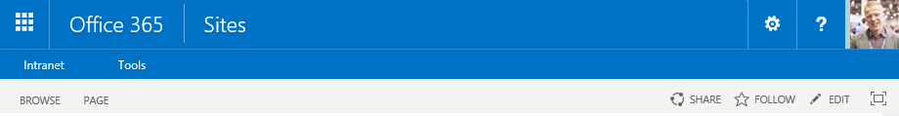
Web control to client side solution
Old model
Custom web control on master page
Full trust solution deployment with its implications
New model
Client-side rendering using JavaScript on the site
Taking usage of the greatly enhanced CSOM and REST APIs in SharePoint
Dynamic update of the capability without maintenance window

Slide 8
JavaScript embedding for web control replacement
Association of JavaScript embedding (user custom action) to the site, so that code is executed during site processing
SharePoint Service
1
Provider Hosted add-ins
CSOM / REST
2
<<Reference>>
js
3
UX component or elements are rendered using CSOM with JavaScript stored either in SharePoint or centrally outside fo the SharePoint, for example in provider hosted add-in site.
Notes:
Vesa

Slide 9
“JavaScript embedding could be impacted if elements in master are changed?”
Correct.
Be aware of any dependency that you take to specific DOM elements. If they change, you could have to rework your scripts.
Notes:
Vesa

Slide 10
Embed second level navigation
Demo
https://github.com/OfficeDev/PnP/tree/master/Samples/OD4B.NavLinksInjection
Notes:
Vesa

Slide 11
UX customizations with add-in model

Slide 12
Add-in Model != Add-in part
There are multiple other patterns you can use…

Slide 13

Extending OOB web parts
What
Rather than implementing custom web parts, provide pre-define out of the box templates which have needed branding and capabilities included
Why
Provides fast and cost efficient way to introduce reusable templates to avoid need of custom web parts or add-in parts
How
Configure OOB web parts, export and use them in web part gallery for other sites
Notes:
Steve
Title: Extending oob web parts
Time: 1 minute
What
Rather than implementing custom web parts, provide pre-define out of the box templates which have needed branding and capabilities included
Why
Provides fast and cost efficient way to introduce reusable templates to avoid need of web parts or web parts
How
Configure out of the box web parts, export and use them in web part gallery for other sites

Slide 14

Steps to bring new web parts to sites
Add OOB web part to page with desired configuration
Export .webpart file from page
Add .webpart file to web part gallery with specific attributes
Start using pre-defined templates with specific links or associations
Note: .webpart files can be added to the site automatically from add-in to web part gallery for enabling new capabilities in host web
Notes:
Steve

Slide 15
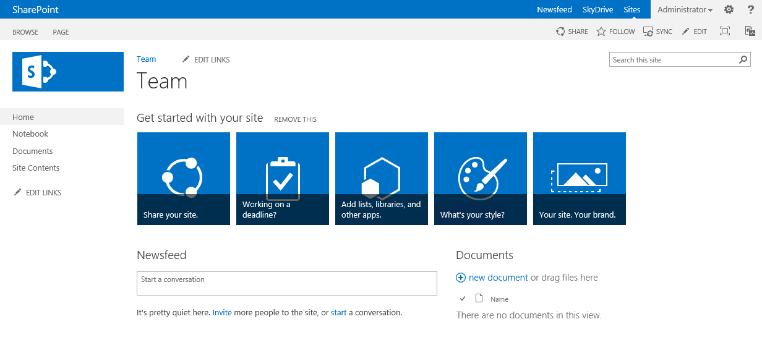
Add-in script part approach
SharePoint Service
SharePoint
1
Add-in Script Part
<div id=“”/>
Provider Hosted add-ins
2
<<Reference>>
3
js
Out of the box script or content editor web part with the needed reference to JavaScritp in the provider hosted add-in side
4
UX component or elements are rendered using CSOM with JavaScript stored either in SharePoint or centrally in the provider hosted add-in side (preferred).
Notes:
Steve

Slide 16
“How would I get that add-in script part included to the sites? Install an add-in?”
Depends.
Normally you’d add the web part definition to the sites during site provisioning. Requires full permissions for add-in, so not suitable for store add-ins.
Notes:
Steve

Slide 17
Web part templates and add-in script part
Demo
https://github.com/OfficeDev/PnP/tree/master/Samples/Core.AppScriptPart

Slide 18
Dialogs with add-in model
What
Add links to specific locations in the SharePoint site and present add-in model options or settings in dialog, so that user does not lose context
Why
Provides additional efficient capability for exposing information or functionalities in the UI with add-in model techniques
How
Use standard SharePoint popup technique to present add-in content in popup
Notes:
Vesa

Slide 19
Dialogs with add-in model
SharePoint Service
SharePoint
1
Add-in Popup
Provider Hosted add-ins
2
<<Load Page>>
aspx
3
4
Usage of out of the box pop up technique to show modal popup for the end user. Can be started from link in a page or for example from custom action.
Provider hosted application is presented in the popup and it can perform needed operations based on the requirements.
Notes:
Vesa

Slide 20
“Wouldn’t this require add-in to be installed to the site?”
Not necessarily.
Depending on your business requirements, using add-in only token could work just as well, which would not required add-in to be installed on site level
Notes:
Vesa

Slide 21
Add-in model dialogs
Demo
https://github.com/OfficeDev/PnP/tree/master/Scenarios/Provisioning.SiteModifier
Notes:
Vesa

Slide 22
Client side rendering

Slide 23
Client side rendering
What
Change how the list fields are being rendered in the list instances or in the list web parts
Why
It’s common that there has to be some adjustment done to the presentations of the individual fields either for presentations for field editing. Replacement technology also for custom fields.
How
Associate JavaScript file to field, list or list view for overriding the rendering of field or even completely change the look and feel of the list.
Notes:
Steve

Slide 24
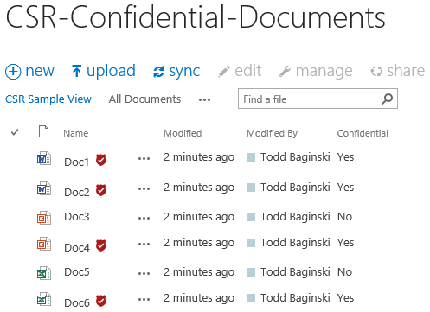
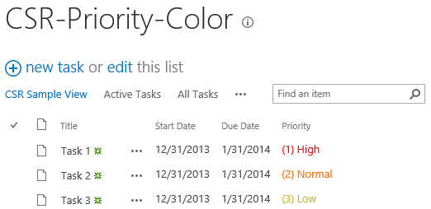
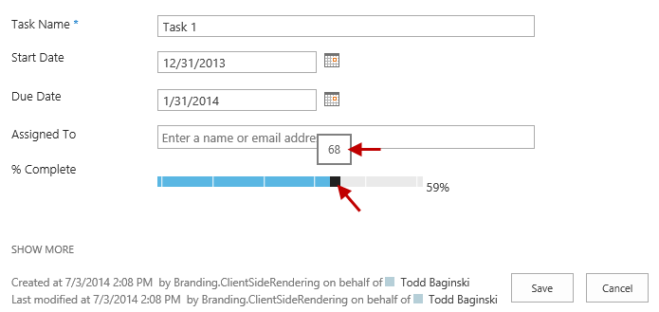
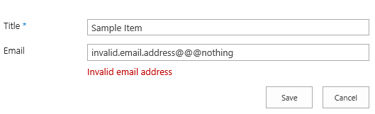
Client side rendering – examples
1
2
Presentiation of information in lists can be modified using client side techniques.
Editing expirience can be adjusted based on the requirements.
4
3
Notes:
Steve

Slide 25
Client side rendering
Association of client side rendering enbedding to field, view or web part, so that client side library is included to the rendering process when content is viewed.
SharePoint Service
1
Provider Hosted add-ins
CSOM / REST
2
<<Reference>>
js
3
UX component or elements are rendered using CSOM with JavaScript stored either in SharePoint site or referenced from provider hosted add-in side.
JavaScript will override the detault read or edit experience of the functionality.
Notes:
Steve

Slide 26
“Are site columns and views configured with the feature framework?”
No.
You’d once again use the remote provisioning technique to apply the needed settings to site elements during site provisioning.

Slide 27
Client side rendering
Demo
https://github.com/OfficeDev/PnP/tree/master/Samples/Branding.ClientSideRendering

Slide 28
Recommendations
It’s not just about add-in parts
Remote provisioning and configuration
Do not modify suite bar (top navigation)
Careful JS embedding is an option
Notes:
Vesa

Slide 29
Questions?

Slide 30

Sharing is caring…
Reusable code samples
Guidance documentation
Monthly community calls
Case Studies
SharePoint Framework
SharePoint add-ins
Microsoft Graph
Remote API access
http://aka.ms/SharePointPnP

Slide 31


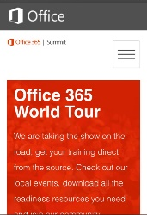
dev.office.com
Sign up
http://dev.office.com/getting-started
Explore
http://apisandbox.msdn.microsoft.com
Get trained http://dev.office.com/training

Slide 32


Feedback
Office 365 Network Share you best practices and join conversations
https://www.yammer.com/itpronetwork
Stackoverflow Ask deep technical questions to a world-wide set of developers
http://stackoverflow.com/questions/tagged/ms-office
UserVoice Provide suggestions of what you want in future versions
http://officespdev.uservoice.com/

Slide 33


© 2015 Microsoft Corporation. All rights reserved. Microsoft, Windows, and other product names are or may be registered trademarks and/or trademarks in the U.S. and/or other countries.
The information herein is for informational purposes only and represents the current view of Microsoft Corporation as of the date of this presentation. Because Microsoft must respond to changing market conditions, it should not be interpreted to be a commitment on the part of Microsoft, and Microsoft cannot guarantee the accuracy of any information provided after the date of this presentation. MICROSOFT MAKES NO WARRANTIES, EXPRESS, IMPLIED OR STATUTORY, AS TO THE INFORMATION IN THIS PRESENTATION.

